Slide 1

BIA-670

Slide 2
Monte Carlo Simulation
BIA-670
Lecture 4
Ricardo A. Collado Assistant Professor School of Business

Slide 3
Random Number
What is random number? Is 3?
There is no such thing as single random number
Random number intuition:
A set of numbers that have nothing to do with the other numbers in the sequence
In a uniform distribution of random numbers in the range [0,1] , every number has the same chance of turning up.
0.00001 is just as likely as 0.5000

Slide 4
Random v. Pseudo-random
Random numbers have no defined sequence or formulation. Thus, for any n random numbers, each appears with equal probability.
If we restrict ourselves to the set of 32-bit integers, then our numbers will start to repeat after some very large n. The numbers thus clump within this range and around these integers.
Due to this limitation, computer algorithms are restricted to generating what we call pseudo-random numbers.

Slide 5
Monte-Carlo Methods
1953, Nicolaus Metropolis
Monte Carlo method refers to many methods that makes use of random numbers
Simulation of natural phenomena
Simulation of experimental apparatus
Numerical analysis

Slide 6
How to generate random numbers ?
Use some chaotic system (Balls in a barrel – Lotto)
Use a process that is inherently random
Radioactive decay
Thermal noise
Cosmic ray arrival
Tables of a few million random numbers
Hooking up a random machine to a computer.

Slide 7
Pseudo Random number generators
The closest random number generator that can be obtained by computer algorithm.
Usually a uniform distribution in the range [0,1]
Most pseudo random number generators have two things in common
The use of large prime numbers
The use of modulo arithmetic
Algorithm generates integers between 0 and M, map to zero and one.

Slide 8
An early example:
John Von Neumann,1946
To generate 10 digits of integer
Start with one of 10 digits integers
Square it and take middle 10 digits from answer
Example: 5772156649² = 33317792380594909291
The sequence appears to be random, but each number is determined from the previous → not random.
Serious problem : Small numbers (0 or 1) are lumped together, it can get itself to a short loop. For example:
6100² = 37210000
2100² = 04410000
4100² = 16810000
5100² = 65610000

Slide 9
Linear Congruential Method
Lehmer, 1948
Most typical so-called random number generator
Algorithm :
a, c >= 0 , m > I₀, a, c
Advantage :
Very fast
Problem :
Poor choice of the constants can lead to very poor sequence
The relationship will repeat with a period no greater than m (around m/4)
C complier RAND_MAX : m = 32767

Slide 10
RANDU Generator
1960’s IBM
Algorithm
This generator was later found to have a serious problem

Slide 11
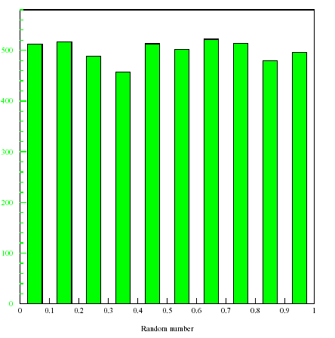
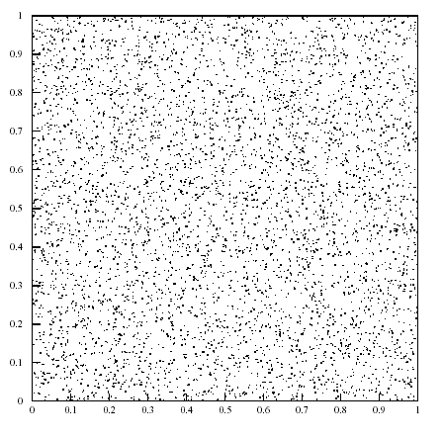
1D and 2D Distribution of RANDU
No problems here …

Slide 12
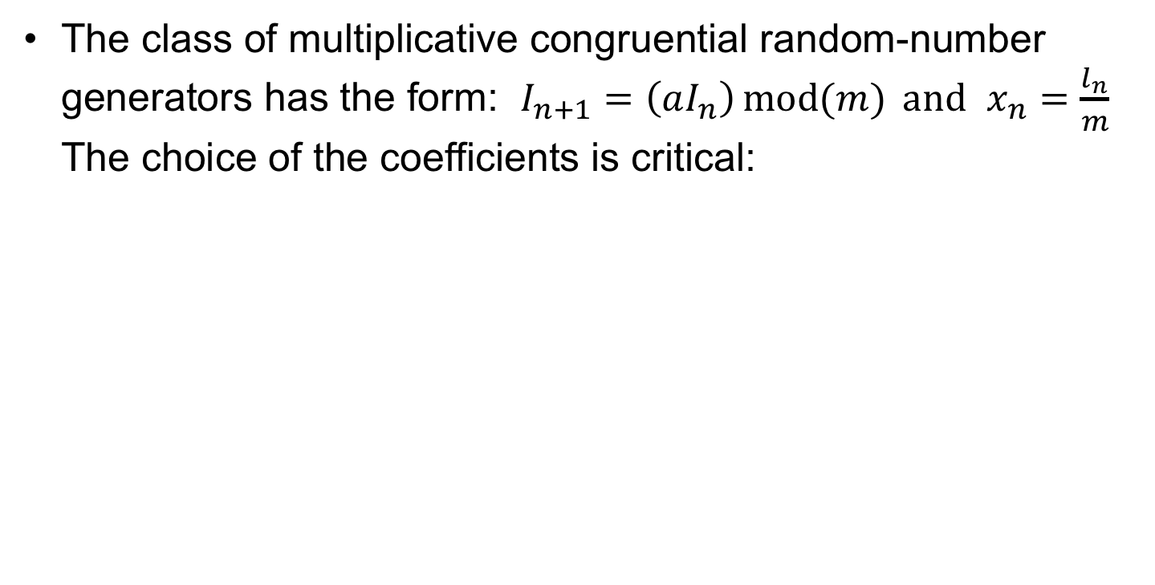
Random Number Algorithms
The class of multiplicative congruential random-number generators has the form: $I_{n+1}=\left(aI_{n}\right)\operatorname{mod}{(m)} and$ $x_{n}=\frac{l_{n}}{m}$ The choice of the coefficients is critical:

Slide 13
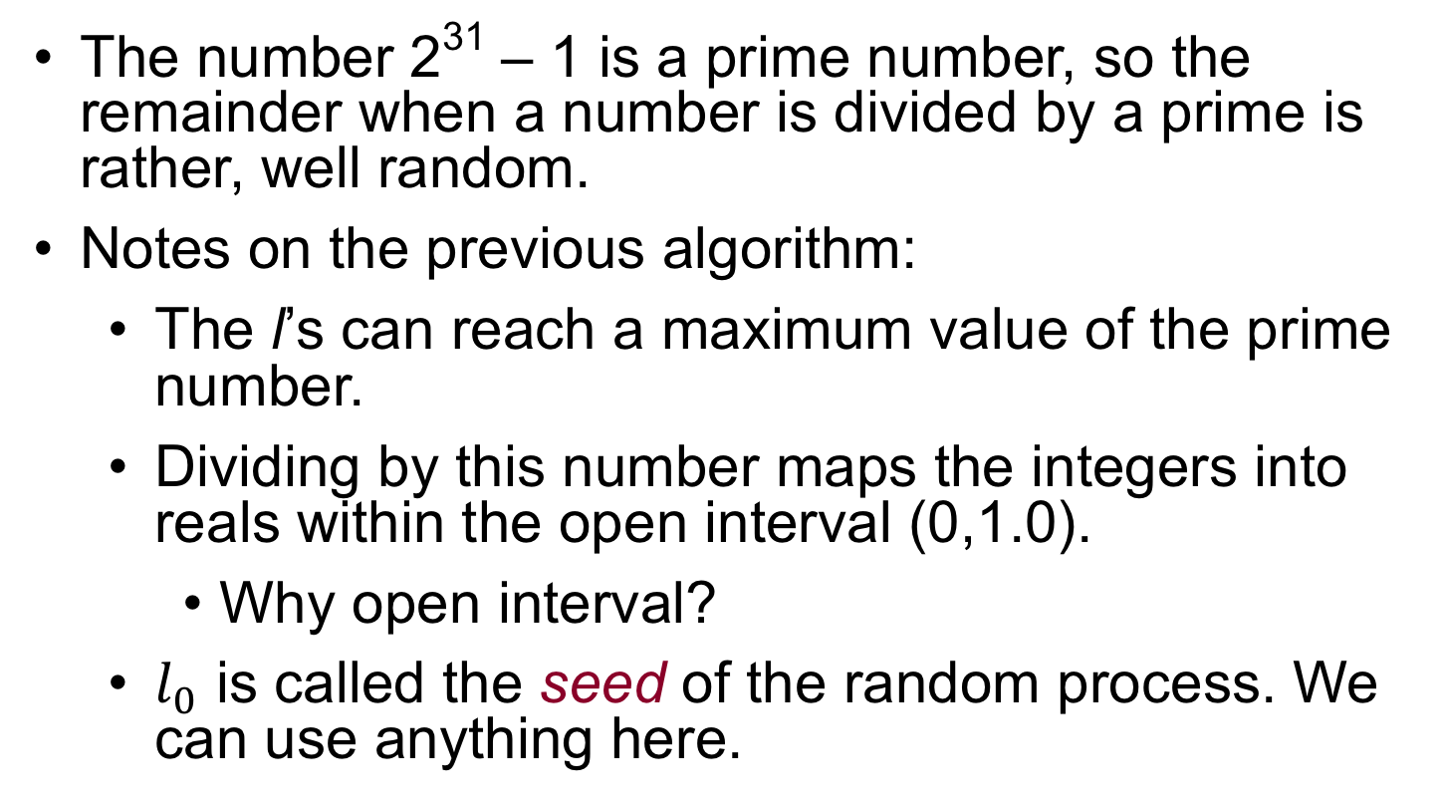
Use of Prime Numbers
The number 2³¹ – 1 is a prime number, so the remainder when a number is divided by a prime is rather, well random.
Notes on the previous algorithm:
The l’s can reach a maximum value of the prime number.
Dividing by this number maps the integers into reals within the open interval (0,1.0).
Why open interval?
$l_{0}$ is called the seed of the random process. We can use anything here.

Slide 14
Other Algorithms
Multiply by a large prime and take the lower-order bits.
Here, we use higher-bit integers to generate 48-bit random numbers.
Drand48()

Slide 15
Other Algorithms
Many more such algorithms.
Some do not use integers. Integers were just more efficient on old computers.
t is any large number
What is this operation?

Slide 16
Other Algorithms
One way to improve the behavior of random number generator
Has two initial seed and can have a period greater than m

Slide 17
The RANMAR generator
Available in the CERN Library
Requires 103 initial seed
Period : about 10⁴³
This seems to be the ultimate random number generator

Slide 18
Properties of Pseudo-Random Numbers
Three key properties that you should remember:
These algorithms generate periodic sequences (hence not random). To see this, consider what happens when a random number is generated that matches our initial seed.

Slide 19
Properties of Pseudo-Random Numbers
The restriction to quantized numbers (a finite-set), leads to problems in high-dimensional space. Many points end up to be co-planar. For ten-dimensions, and 32-bit random numbers, this leads to only 126 hyper-planes in 10-dimensional space.

Slide 20
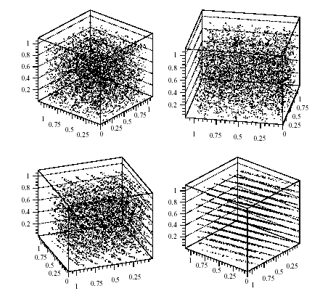
3D Distribution from RANDU
Problems seen when observed at the right angle

Slide 21
The Marsaglia effect
1968, Marsaglia
Randon numbers fall mainly in the planes
The replacement of the multiplier from 65539 to 69069 improves performance significantly

Slide 22
Properties of Pseudo-Random Numbers
The individual digits in the random number may not be independent. There may be a higher probability that a 3 will follow a 5.

Slide 23
Initializing with Seeds
Most of the algorithms have some state that can be initialized. Many times this is the last generated number (not thread safe).
You can set this state using the routines initialization methods (srand, srandom or srand48).
Why would you want to do this?

Slide 24
Initializing with Seeds
Two reasons to initialize the seed:
The default state always generates the same sequence of random numbers. Not really random at all, particularly for a small set of calls. Solution: Call the seed method with the lower-order bits of the system clock.
You need a deterministic process that is repeatable.

Slide 25
Mapping random numbers
Most computer library support for random numbers only provides random numbers over a fixed range.
You need to map this to your desired range.
Two common cases:
Random integers from zero to some maximum.
Random floating-point or double-precision numbers mapped to the range zero to one.

Slide 26
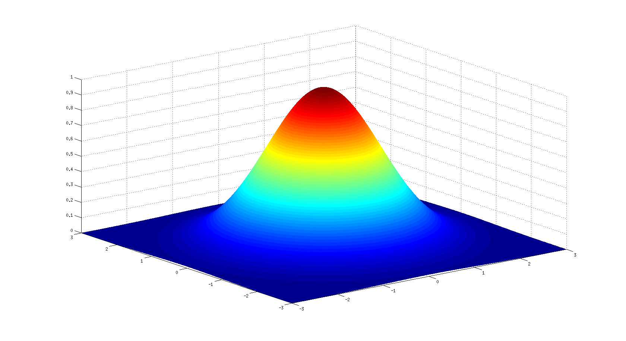
Generating Random Distributions

Slide 27
What is the Monte Carlo method ?
numerical method
Monte Carlo
stochastic process
problem
solution
Theory of Probability and Statistics
How does it work ?
Do it
Design the
experiment
Outcome
problem
…or simulate it
in a computer
What kind of problems can we tackle?
Why Monte Carlo?
incapability?
Particle physics, Bayesian inference,…
What do we get?
Magic Box?,…, more information?...

Slide 28
Basis of Monte Carlo simulations
Do it
Design the
experiment
…or simulate it
on a computer
Get a sequence
Get a sampling of size n from a stochastic process
of random numbers
Need sequences of random numbers
Do not do the experiment but….
generate sequences of pseudo-random numbers on a computer

Slide 29
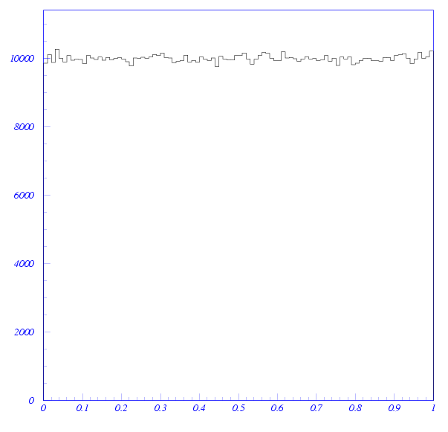
Sampling moments:
Sample size: 10⁶ events

Slide 30
Great! But life is not uniform…
We can generate pseudo-random sequences
with
Physics, Statistics,… we want
to generate sequences from
How?
Inverse Transform
Aceptance-Rejection (“Hit-Miss”)
“Importance Sampling”,…
Usually a combination of them
Tricks:
Normal Distribution

Slide 31
Method 1: Inverse Transform
➢
We want to generate a sample of
➢
How is distributed?
Algorithm
i) Sample
n)
ii) Transform

Slide 32
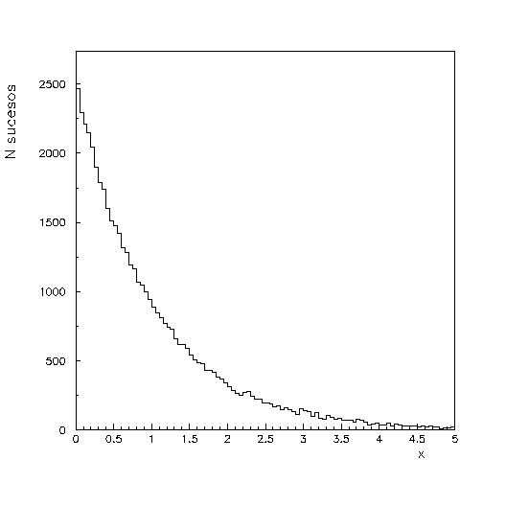
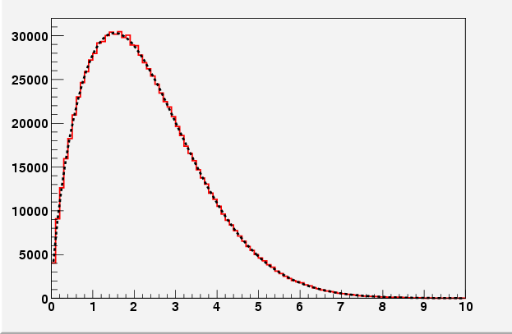
Examples:
Sampling of
Sampling of
…some fun…

Slide 33
For discrete random quantities
…………………
Algorithm
i) Sample
n)
ii) Find

Slide 34
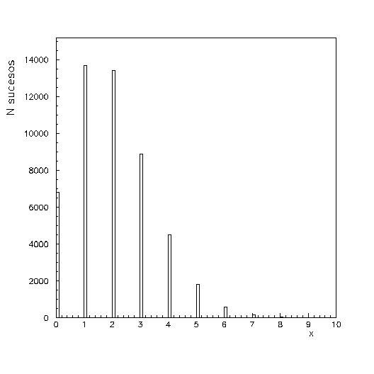
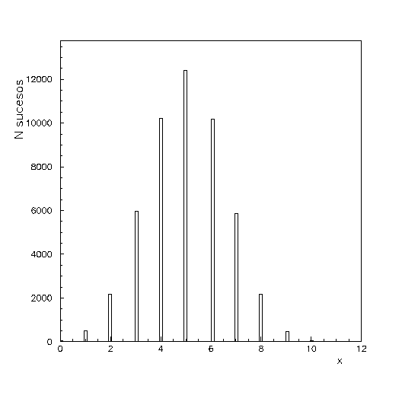
Example: Sampling of
50,000 events
from until
k
50,000 events
Sampling of
from until
n

Slide 35
Even though discrete distributions can be sampled this way,… usually one can find more efficient algorithms…
Example:
i) generate
ii) multiply them
and go to i) while
iii) deliver

Slide 36
Generalization to n dimensions
… trivial but …
and
if are independent
… but if not ...
there are ways to decompose the pdf and some are easier to sample than others

Slide 37
Example:
Marginal Densities:
not independent
Conditional Densities:
dificult
easy

Slide 38
Properties:
Direct and efficient in the sense that
one
one
Useful for many distributions of interest
(Exponential, Cauchy, Weibull, Logistic,…)
…but in general, difficult to invert
numeric approximations are slow,…

Slide 39
Method 2: Acceptance-Rejection
“Hit-Miss” J. Von Neuman, 1951
Sample
1) Enclose the pairs
in a domain
(not necessarily hypercube)
such that:
and
2) Consider a two-dimensional random quantity
uniformly distributed in the domain
; that is:
3) Which is the conditional distribution
?

Slide 40
Algorithm
i) Sample
and
n)
ii) Get
if
accept
if
reject
and go back to i)
rejected
accepted

Slide 41
(pedagogical; low efficiency)
Example:
density:
(normalisation:
…not needed
Covering adjusted for maximum efficiency:
generated in the domain

Slide 42
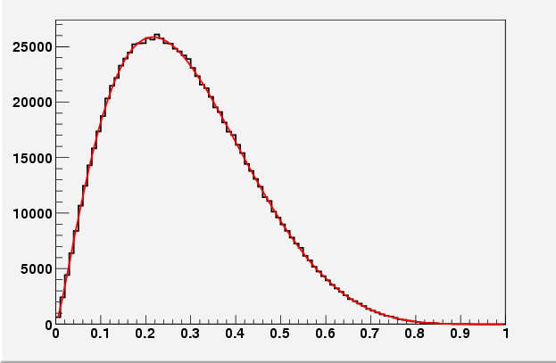
Algorithm
i) Sample
n)
ii) Accept-Reject
if
accept
if
reject
and go to i)

Slide 43
Properties:
Easy to implement and generalize to n dimensions
Efficiency
covering domain
area under
# accepted events
area covering domain
# generated events
is equivalent to the Inverse Transform method
rejected
The better adjusted the covering is, the higher is the efficiency
accepted

Slide 44
Straight forward generalisation to n dimensions
Algorithm:
i) Generate n+1 distributed random quantities
k)
ii) Accept or reject
accept
if
reject if not and go back to i)

Slide 45
Method 3: Importance Sampling
Sample
1) Express
as
probability density
In particular:
2) Consider a sampling of
and apply the acceptance-rejection algorithm to
How are the accepted values distributed?

Slide 46
Algorithm
i) Sample
ii) Apply Acceptance-Rejection to
sample drawn from
…but how do we choose
?

Slide 47
… ∞ ways ...
➢
Easy to invert so we can apply the Inverse Transform Method
Easiest choice:
… is just the aceptance – rejection procedure
➢
We would like to choose so that, instead of sampling uniformly the whole domain , we sample with higher probability from those regions where is “more important”
Take as “close” as possible to
will be ”as flat as possible” (“flatter” than ) and we shall have a high efficiency when applying the acceptance-rejection

Slide 48
Example:
density:
1) We did “standard” acceptance-rejection
2) “Importance Sampling”

Slide 49
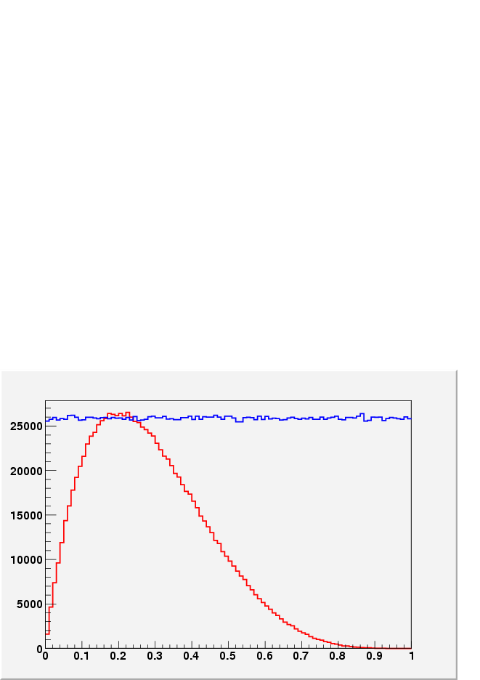
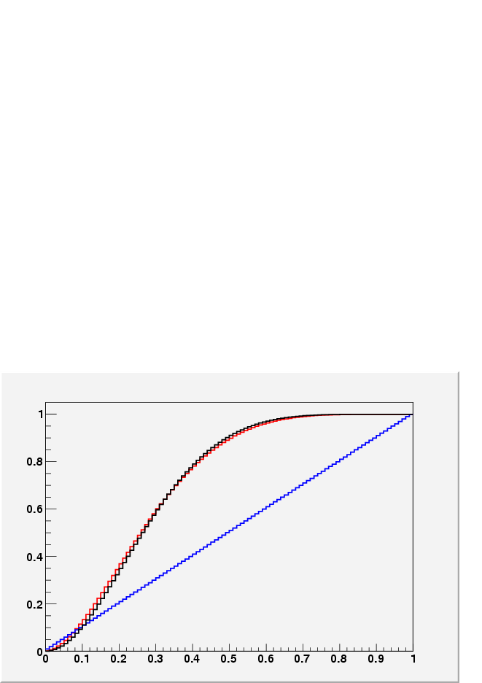
2.1) Generate
2.2) Acceptance-Rejection on
concave on

Slide 50
acceptance-rejection
Importance Sampling

Slide 51
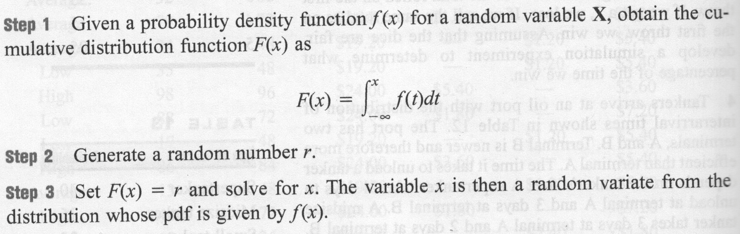
Review:

Slide 52
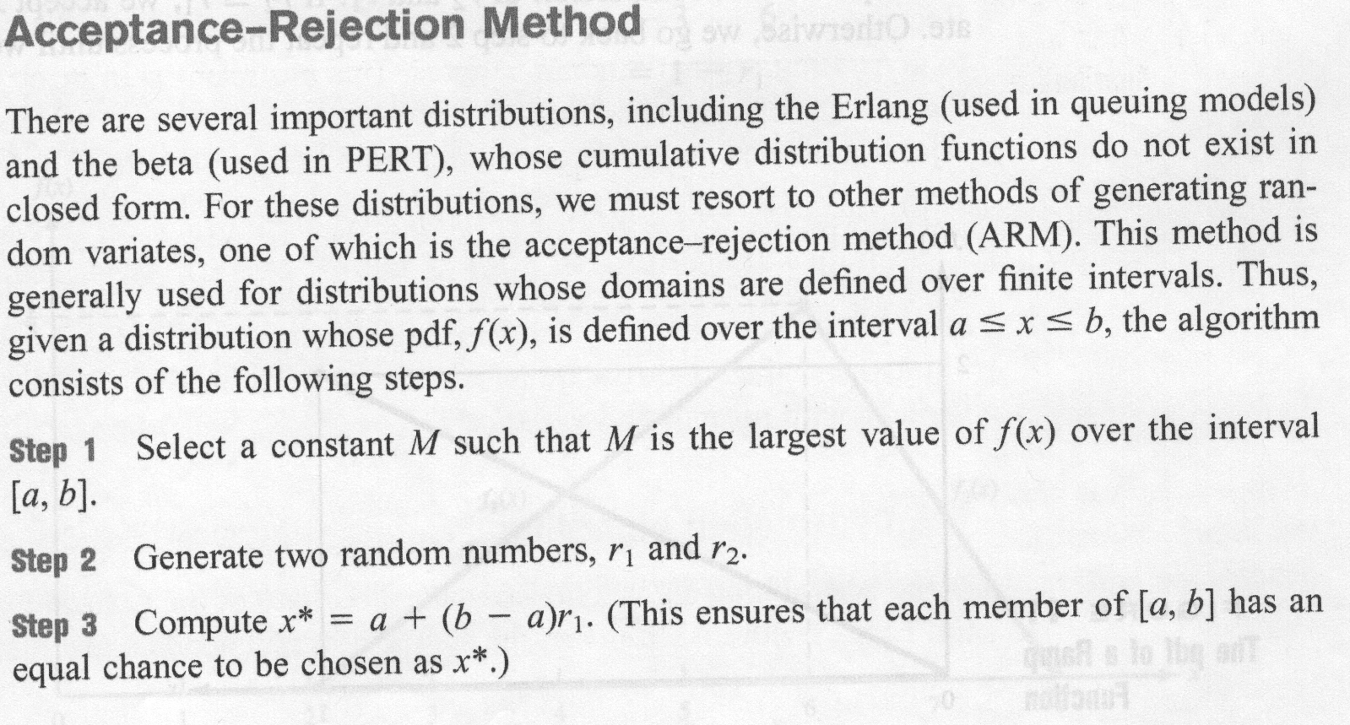
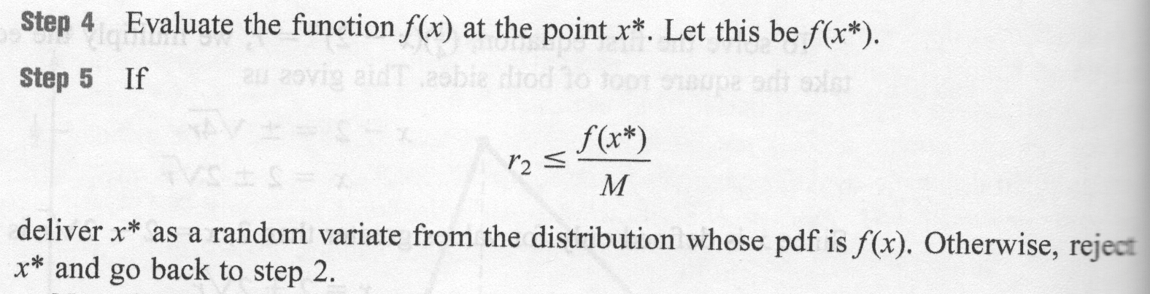

Slide 53
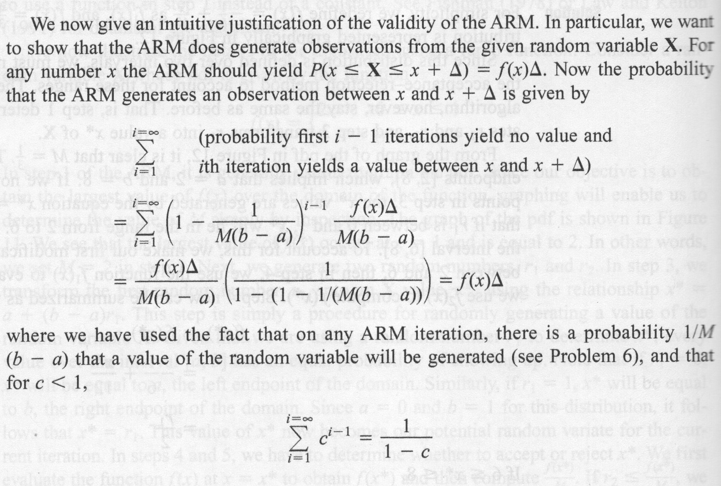

Slide 54
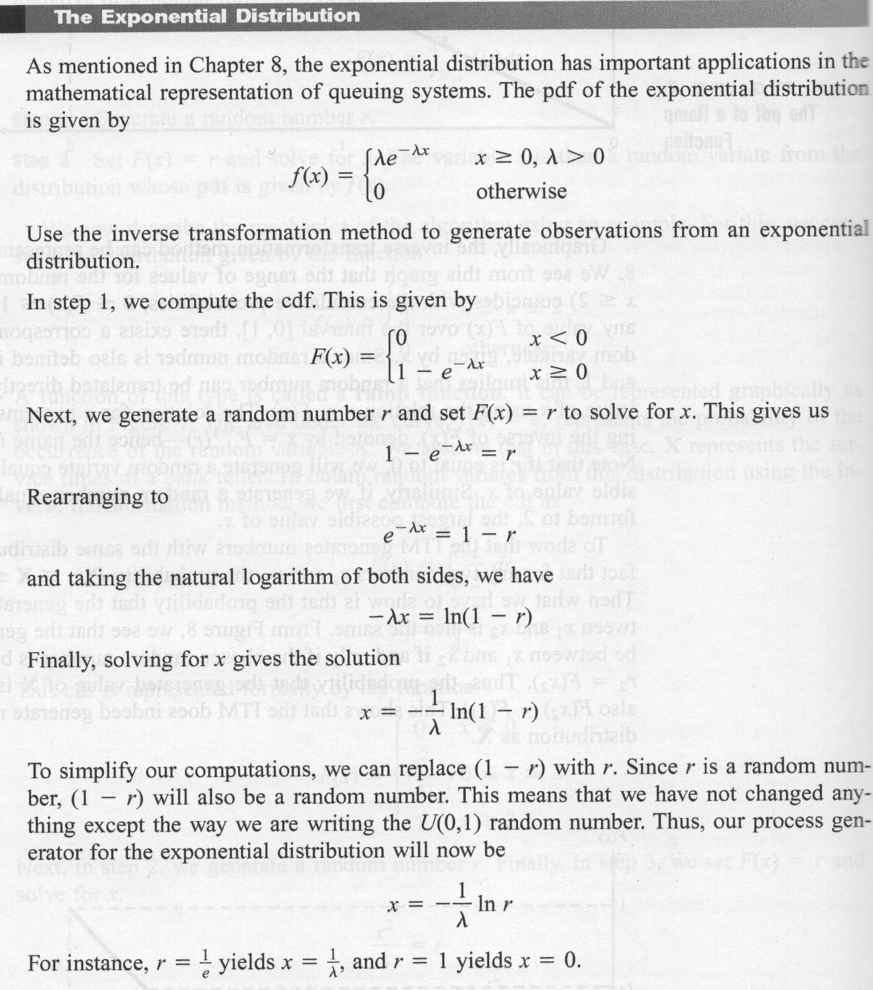
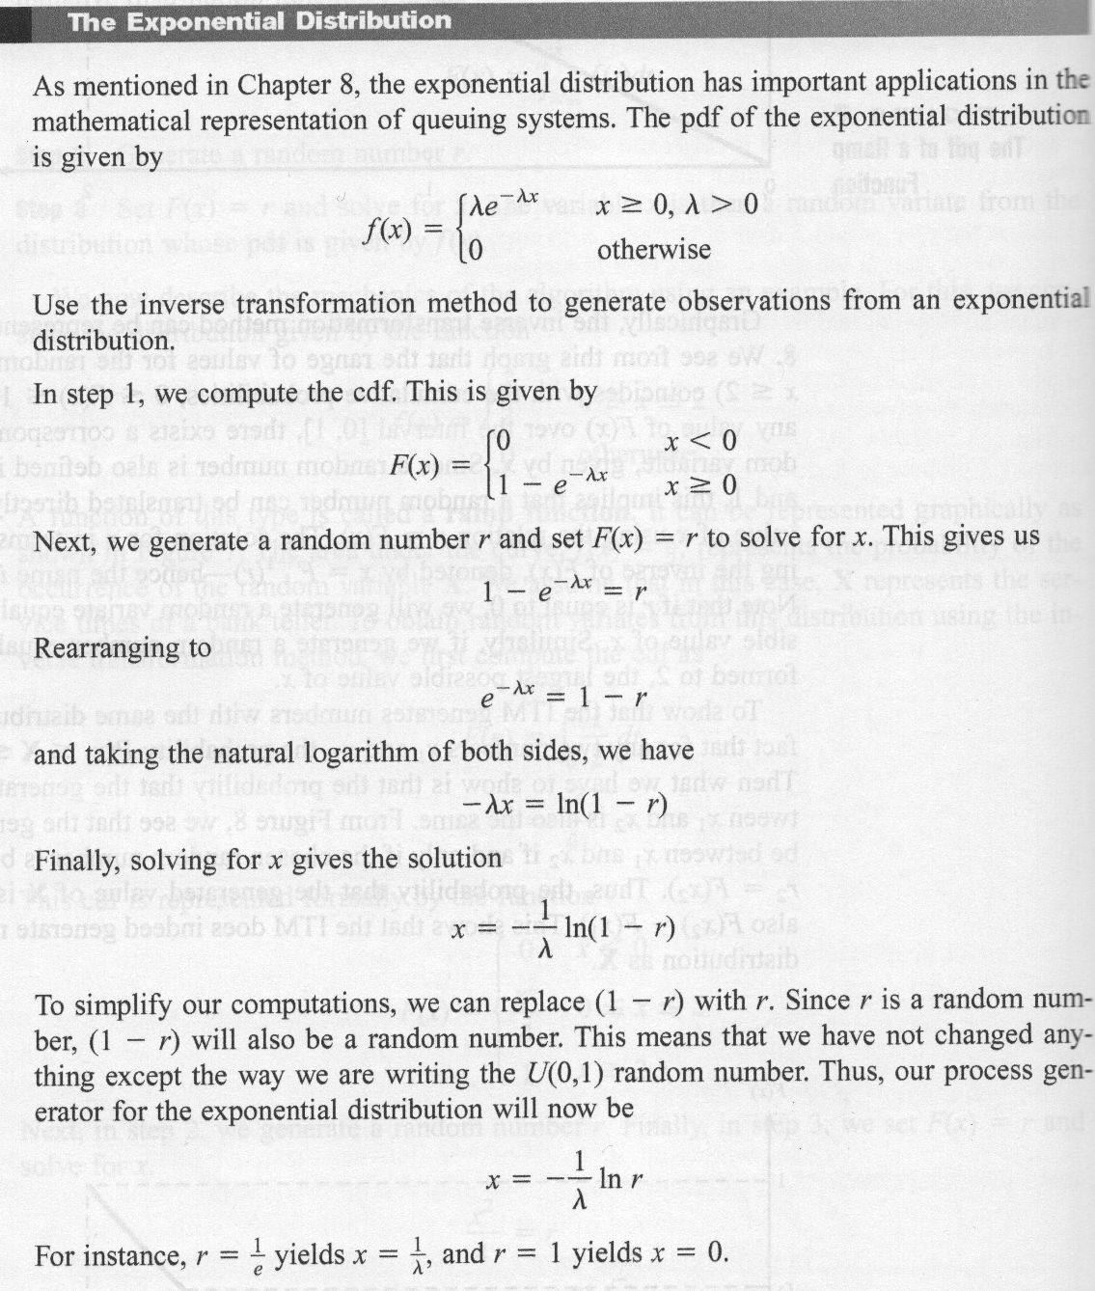

Slide 55
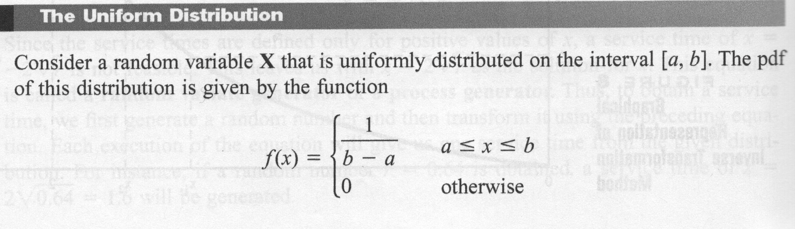
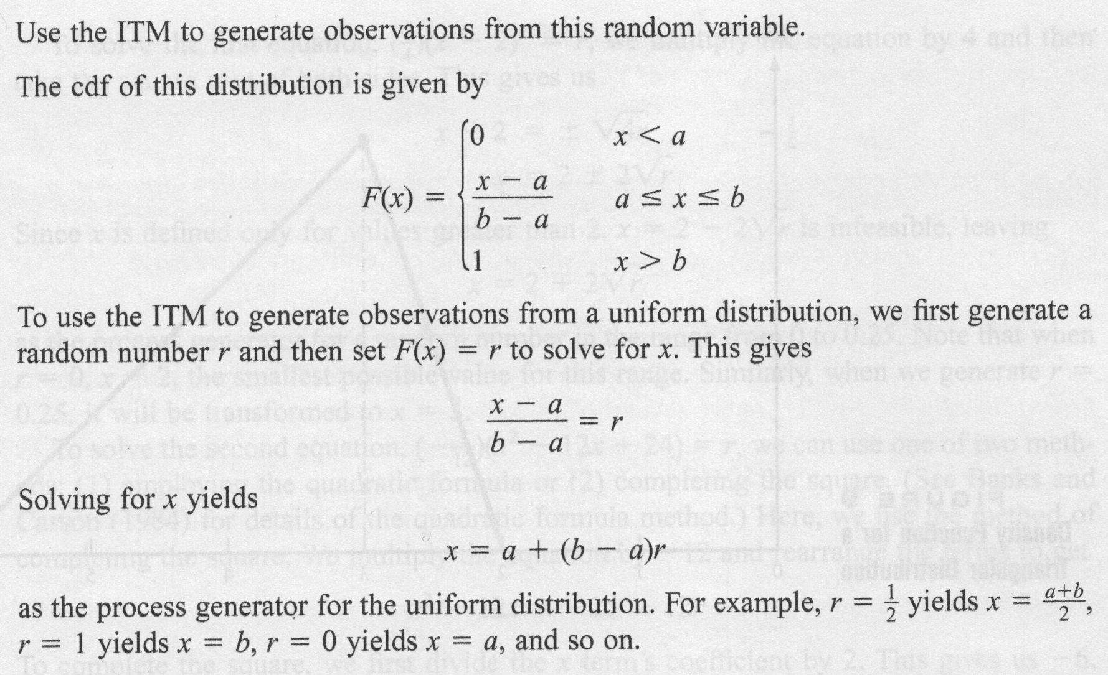

Slide 56
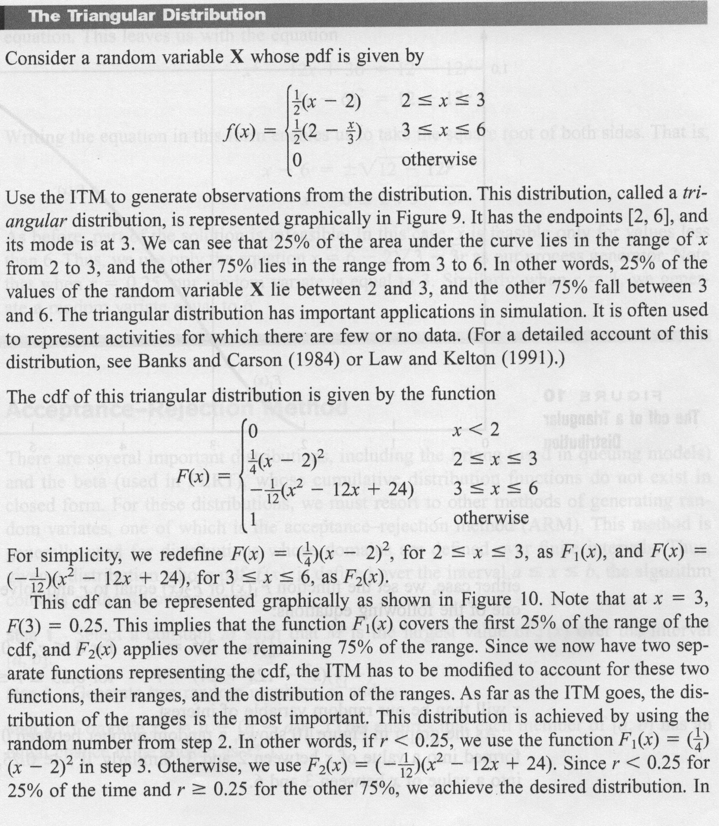

Slide 57
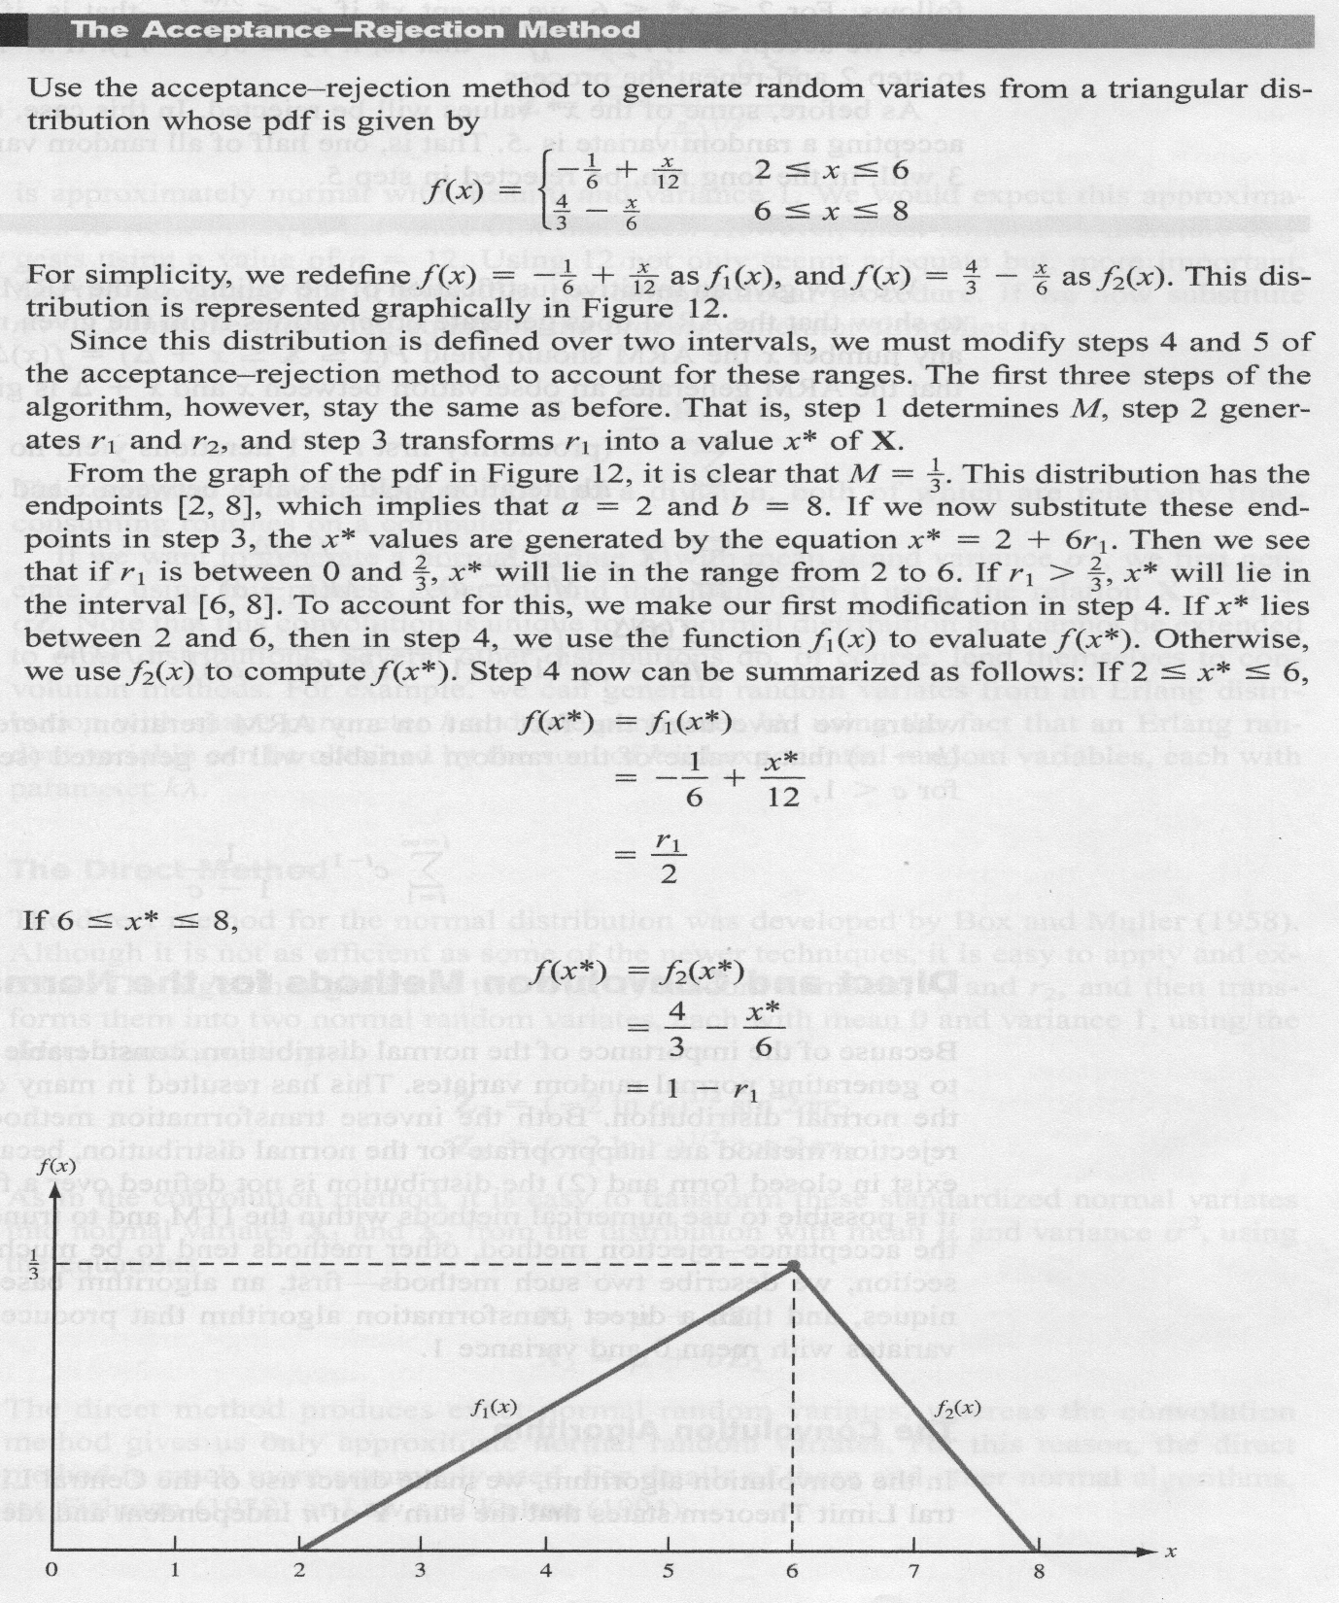

Slide 58
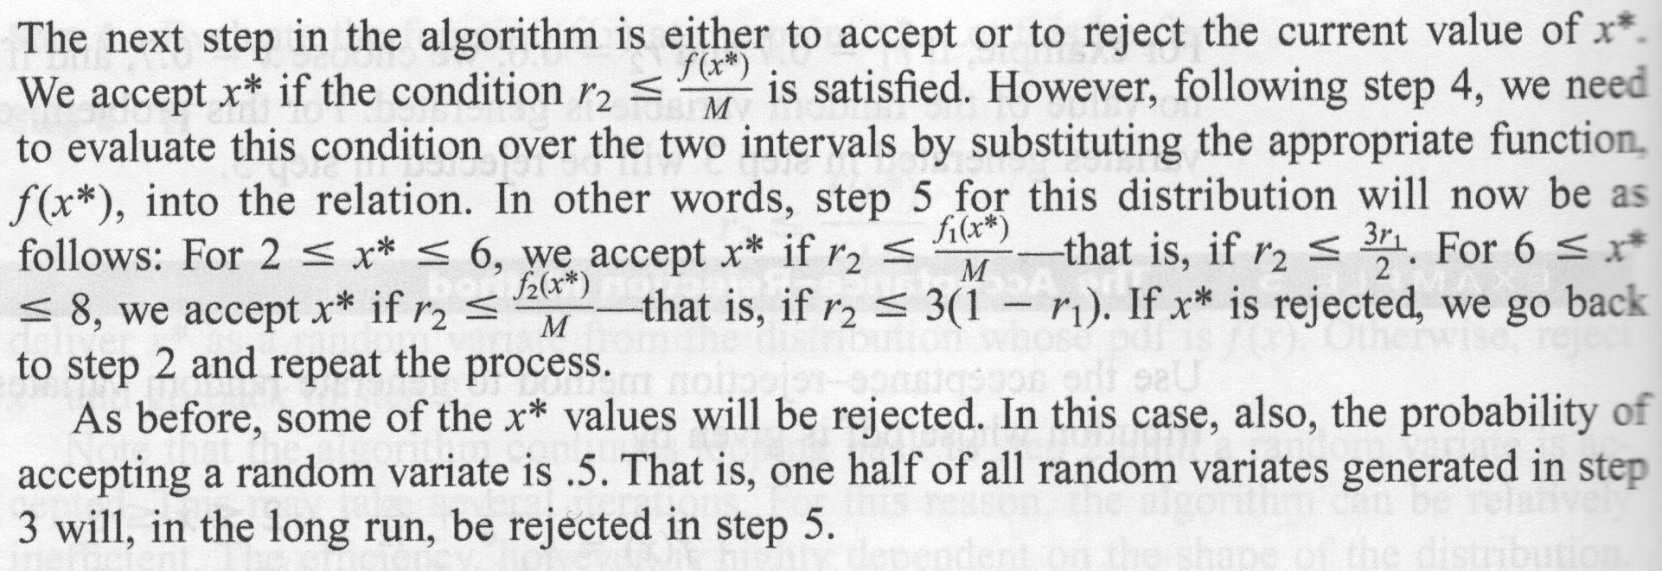

Slide 59
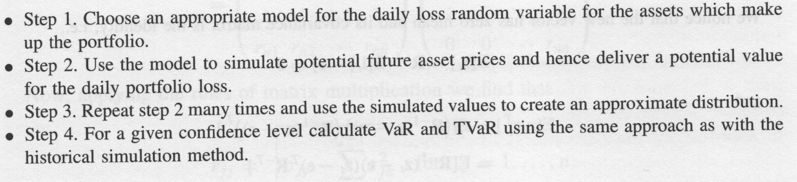
Portfolio Optimization

Slide 60
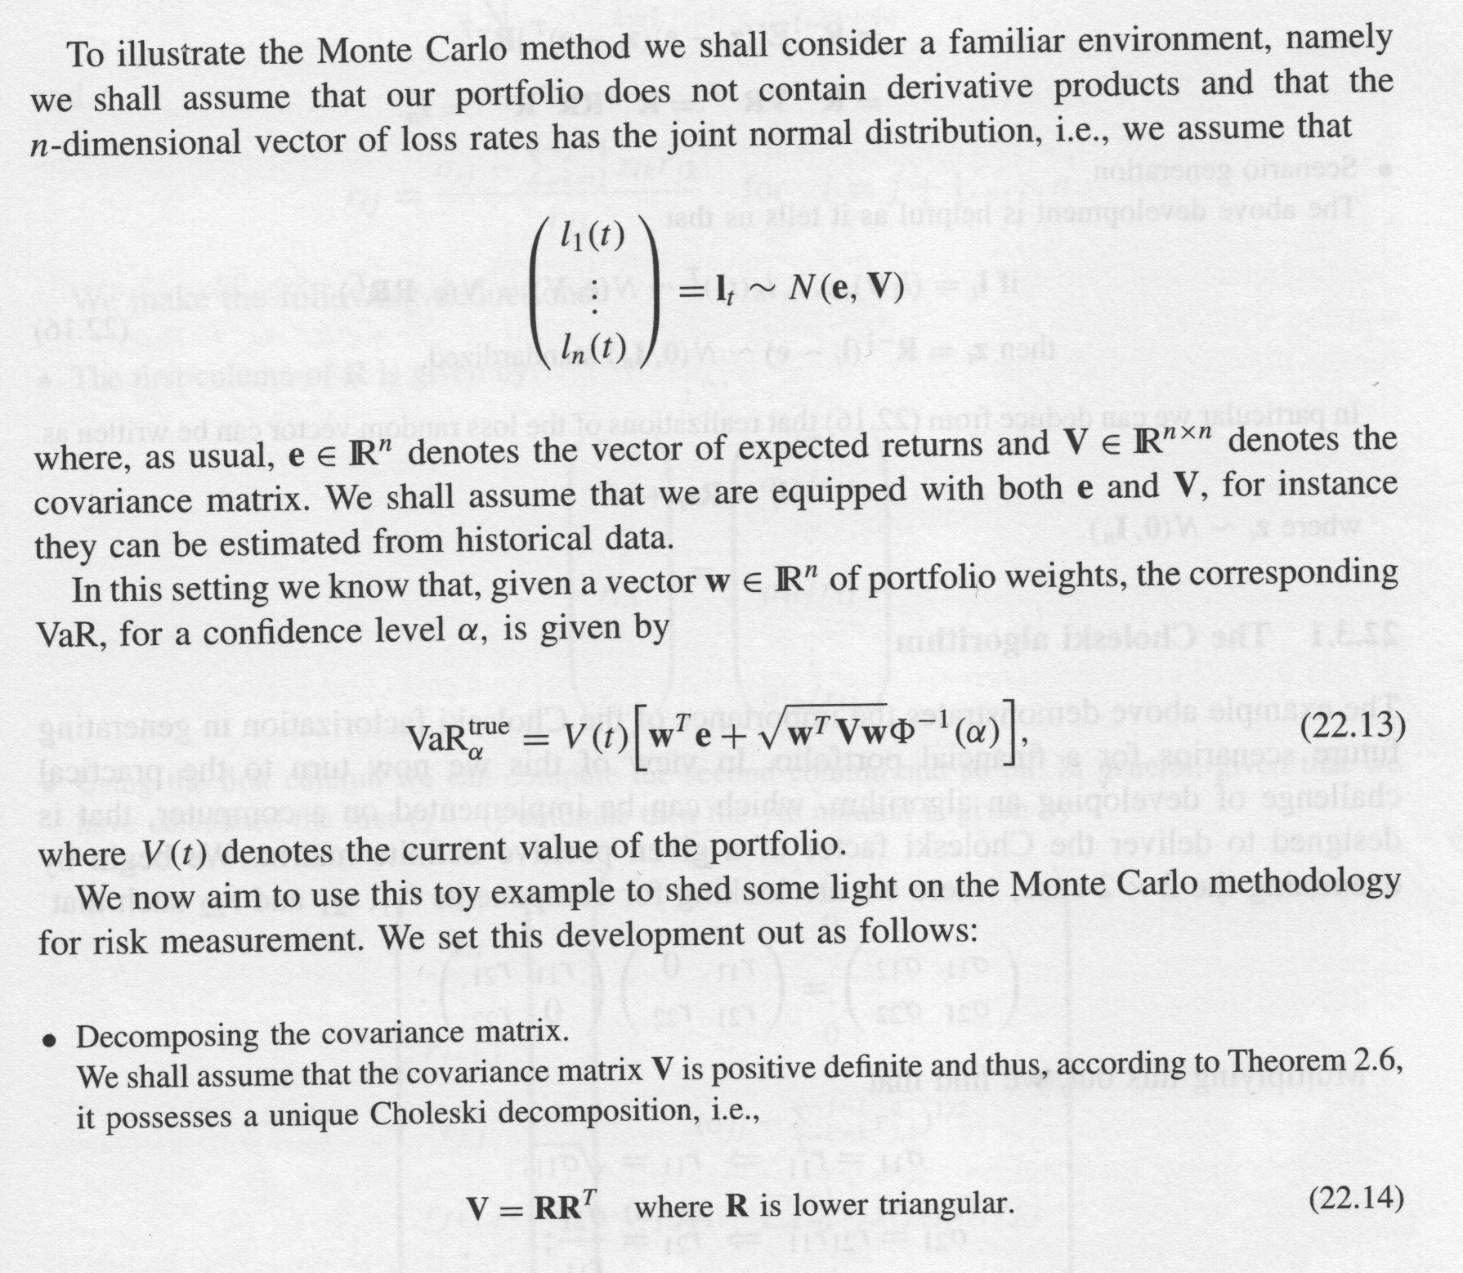

Slide 61
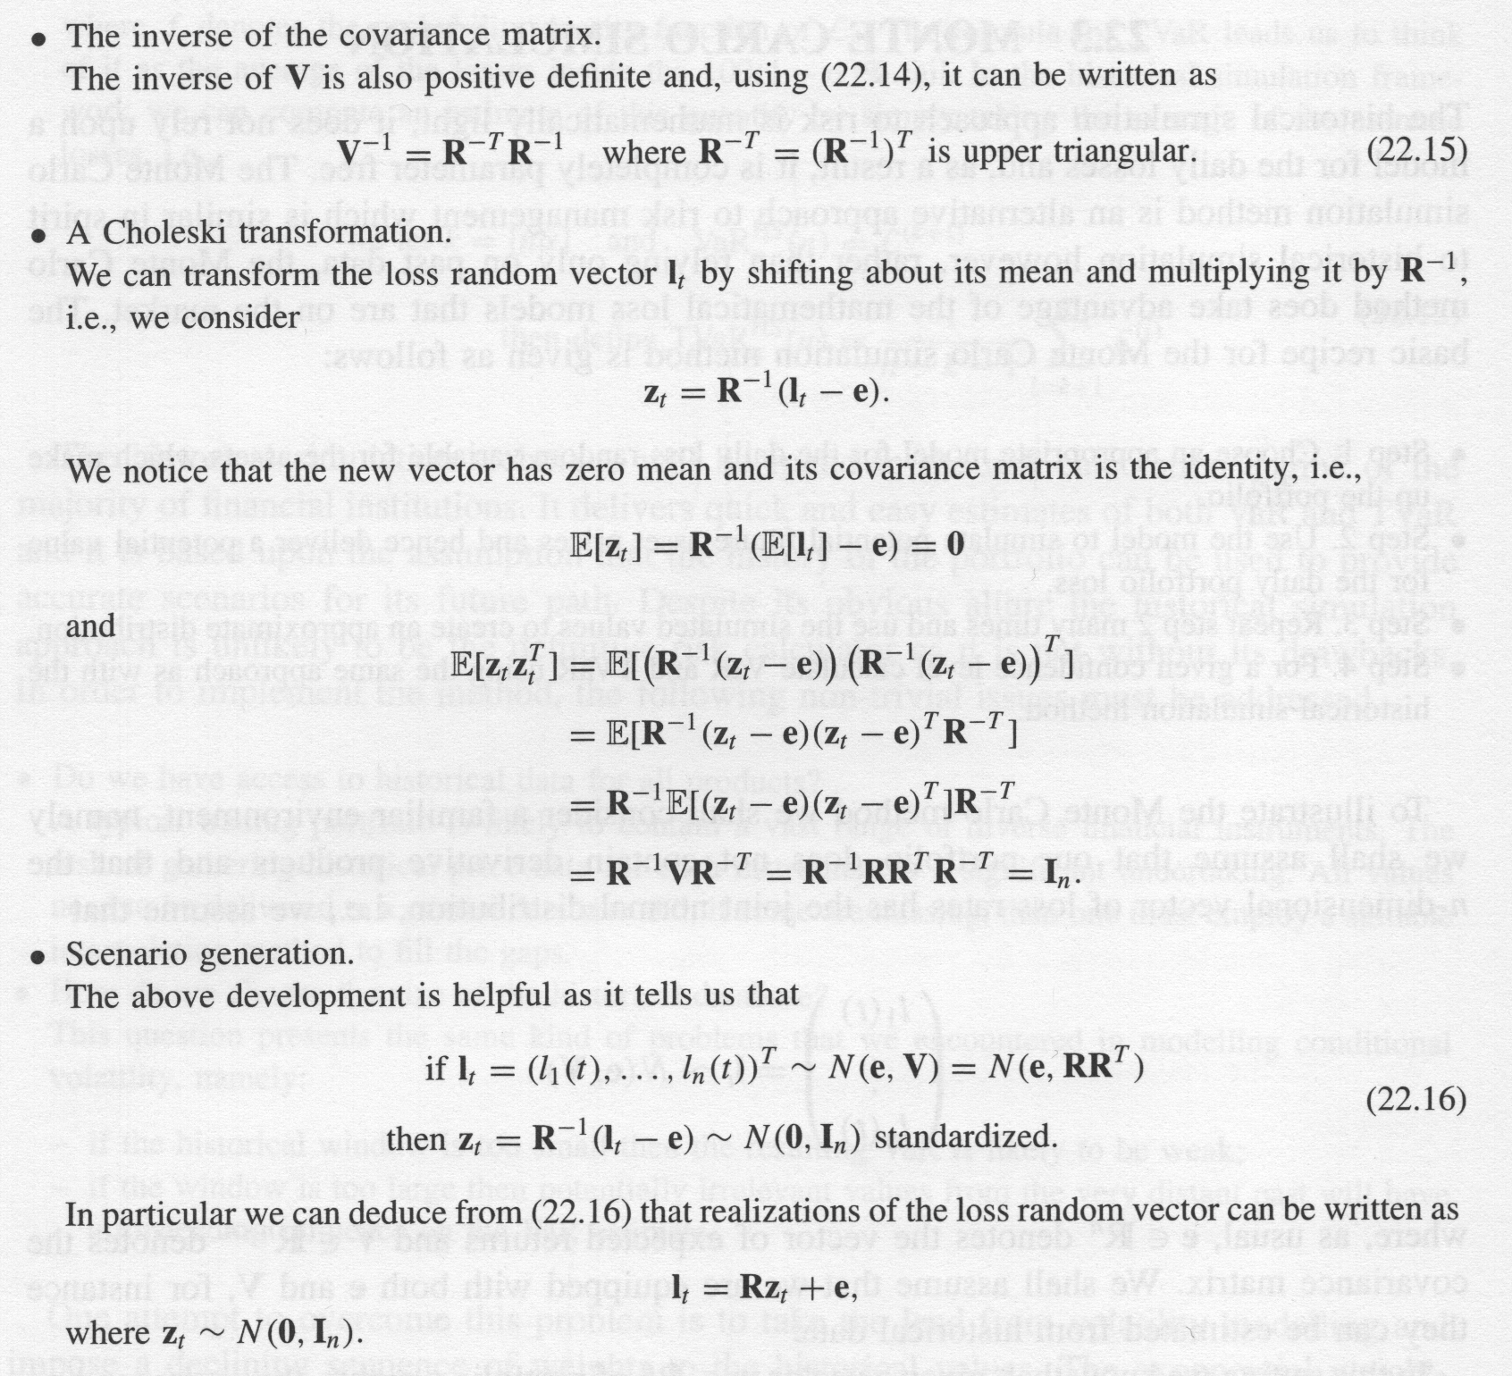

Slide 62
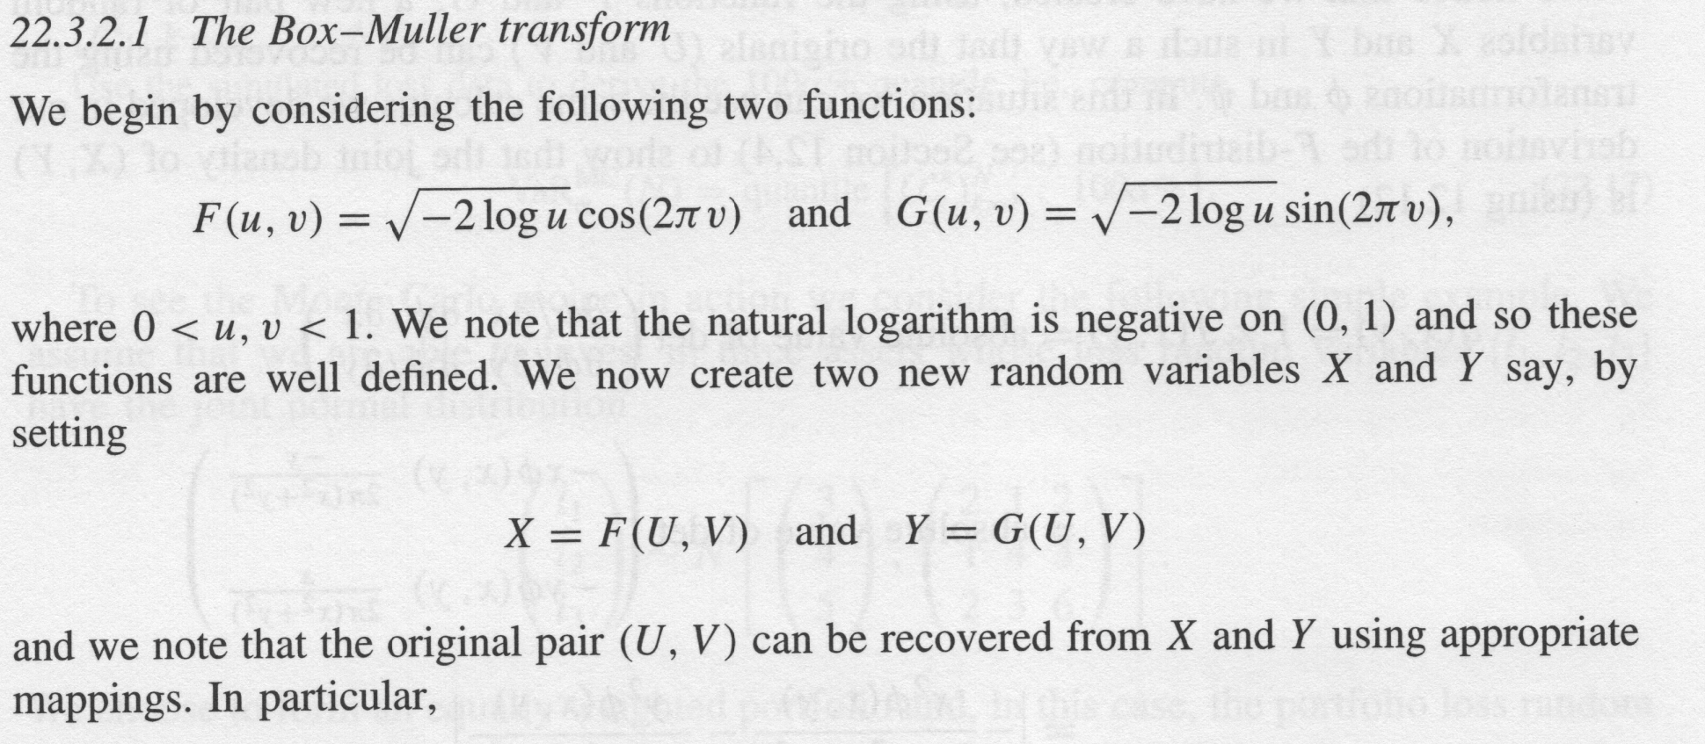
Normal Distribution:

Slide 63
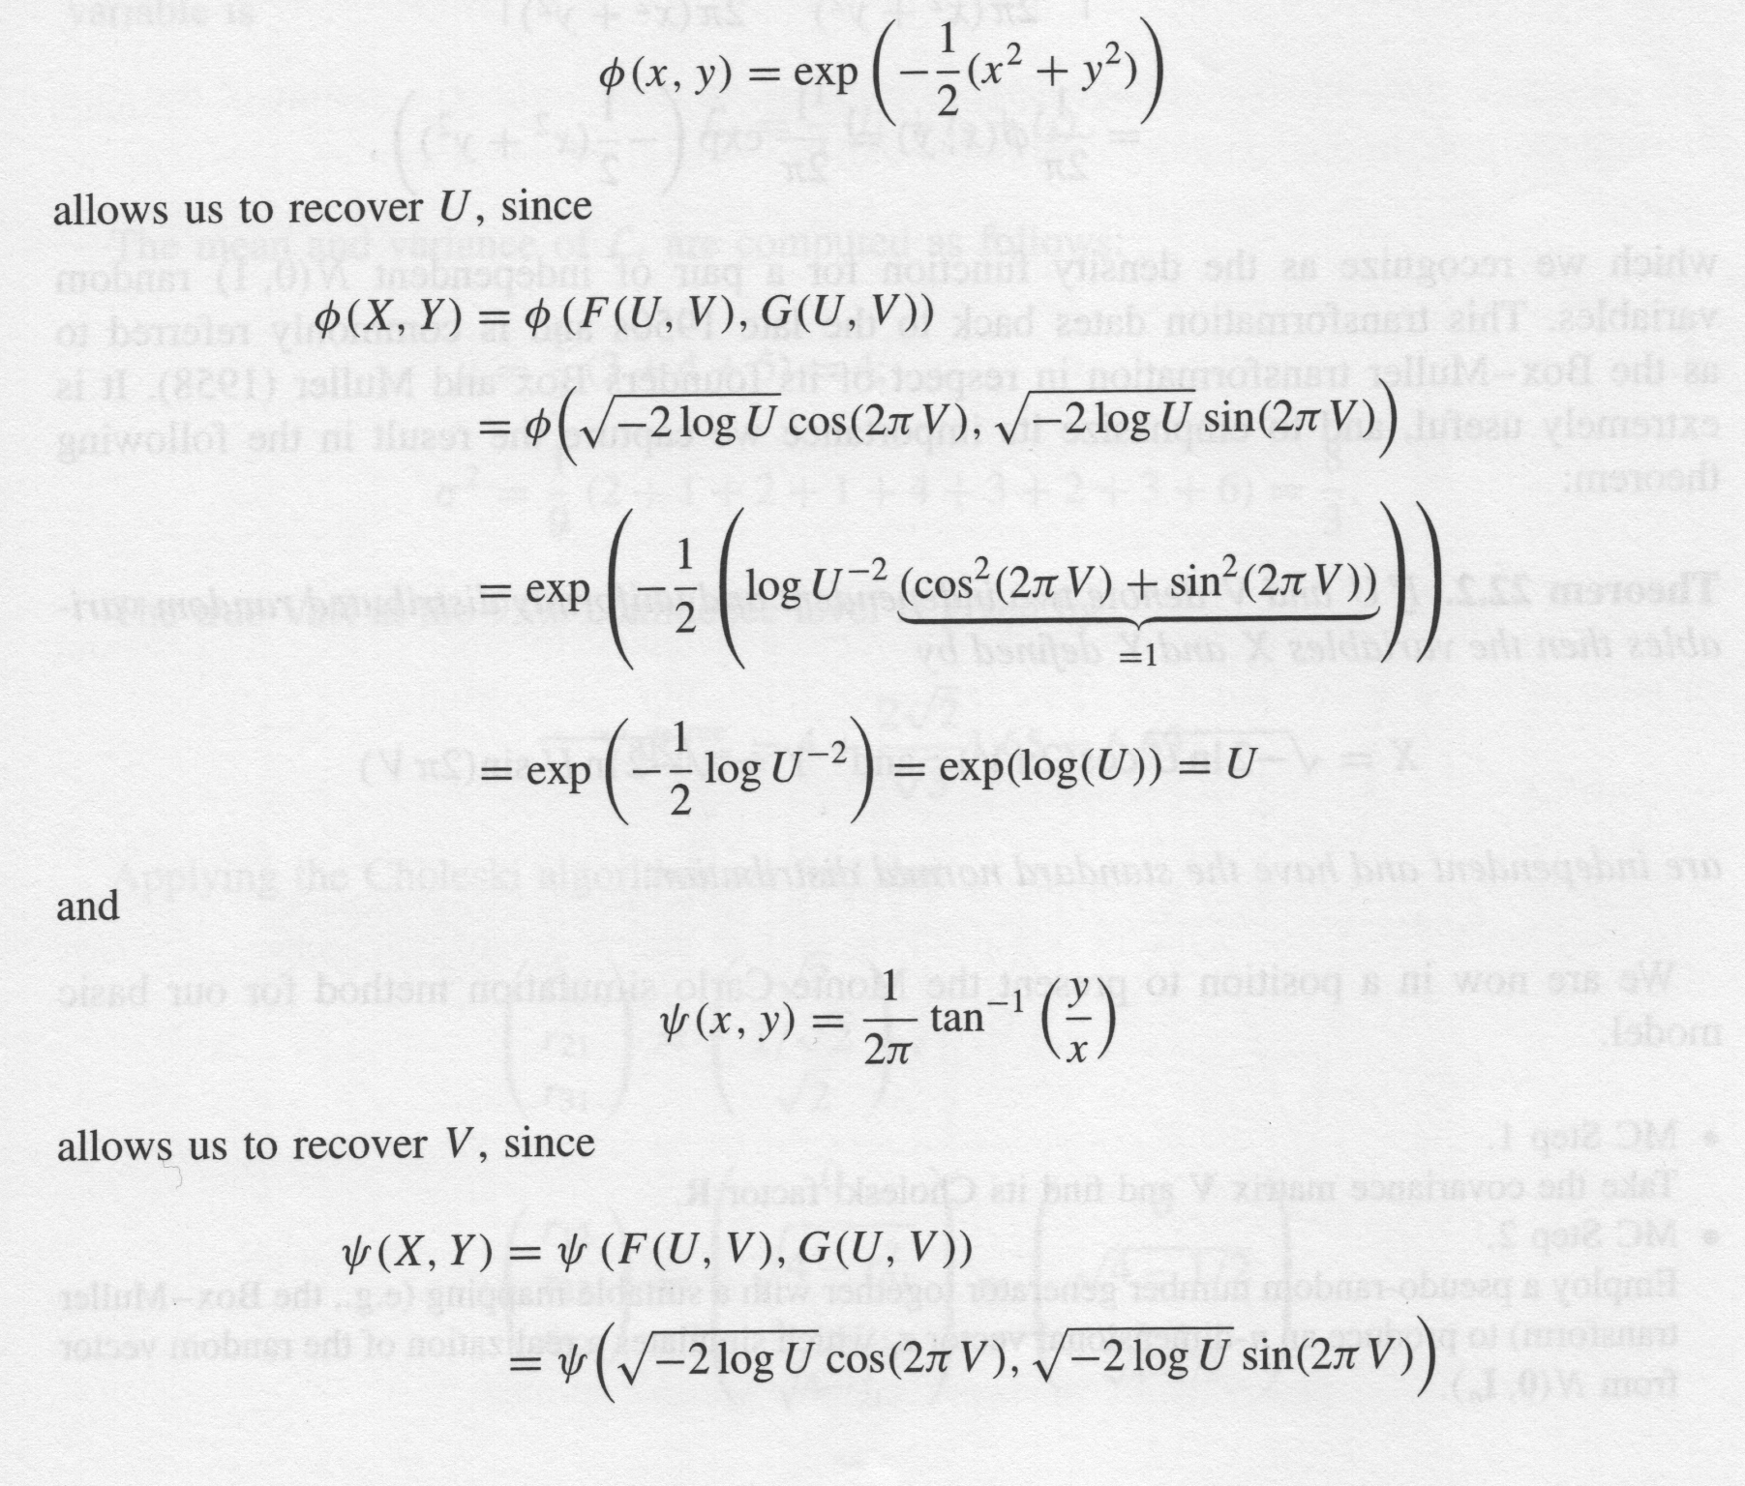

Slide 64
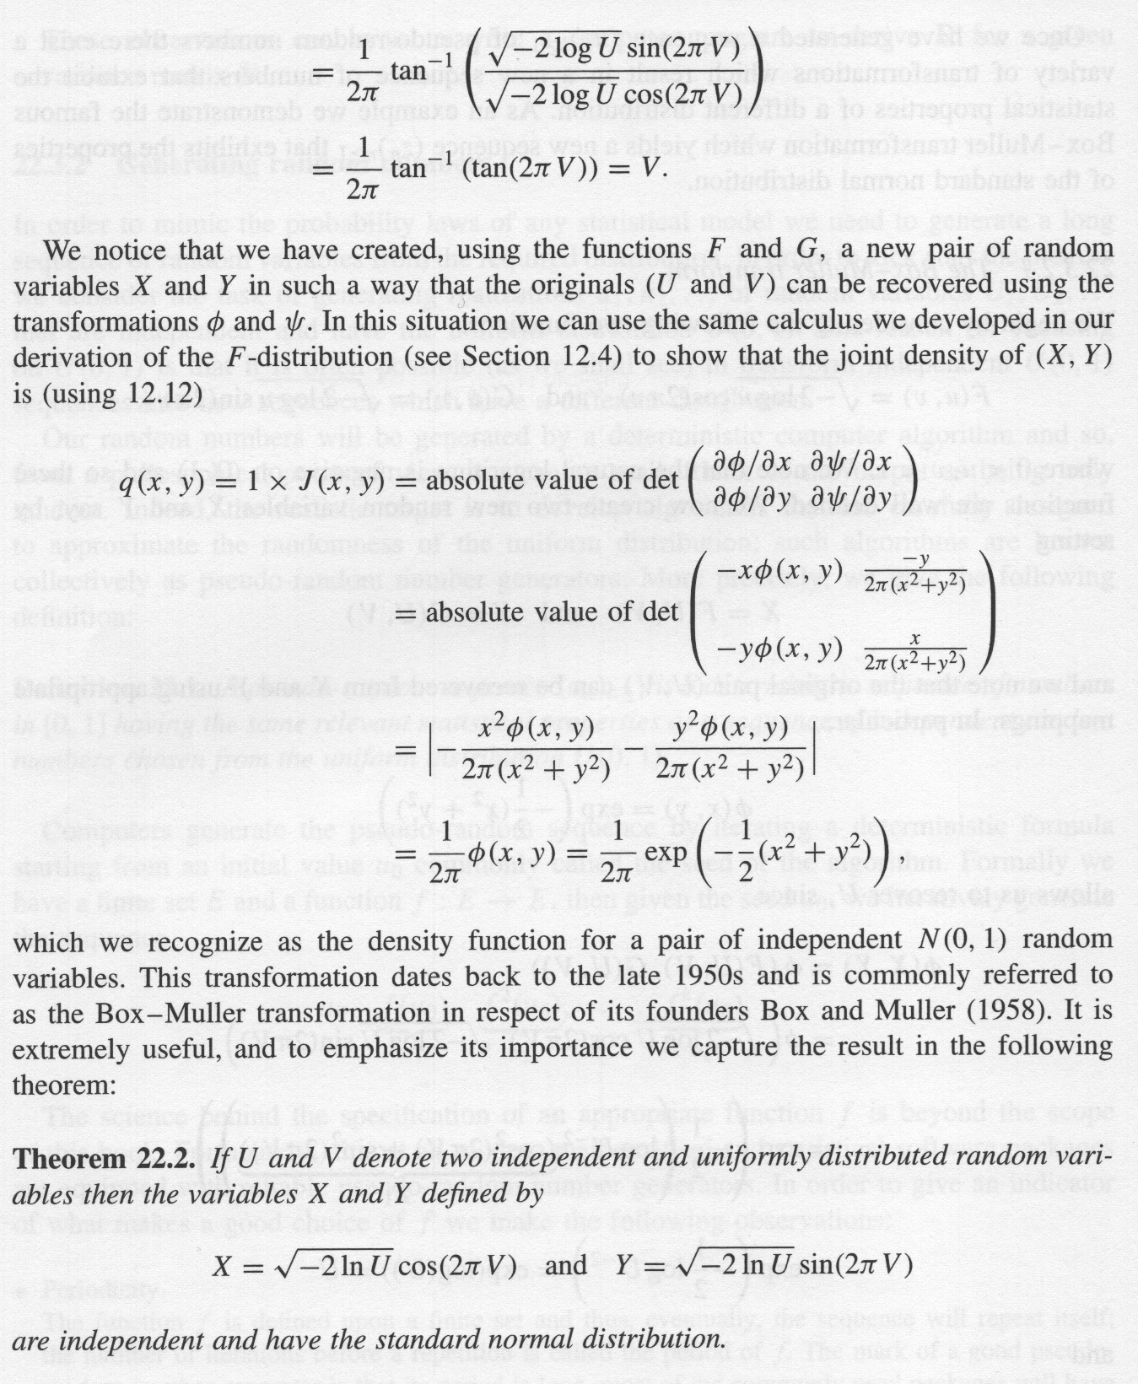

Slide 65
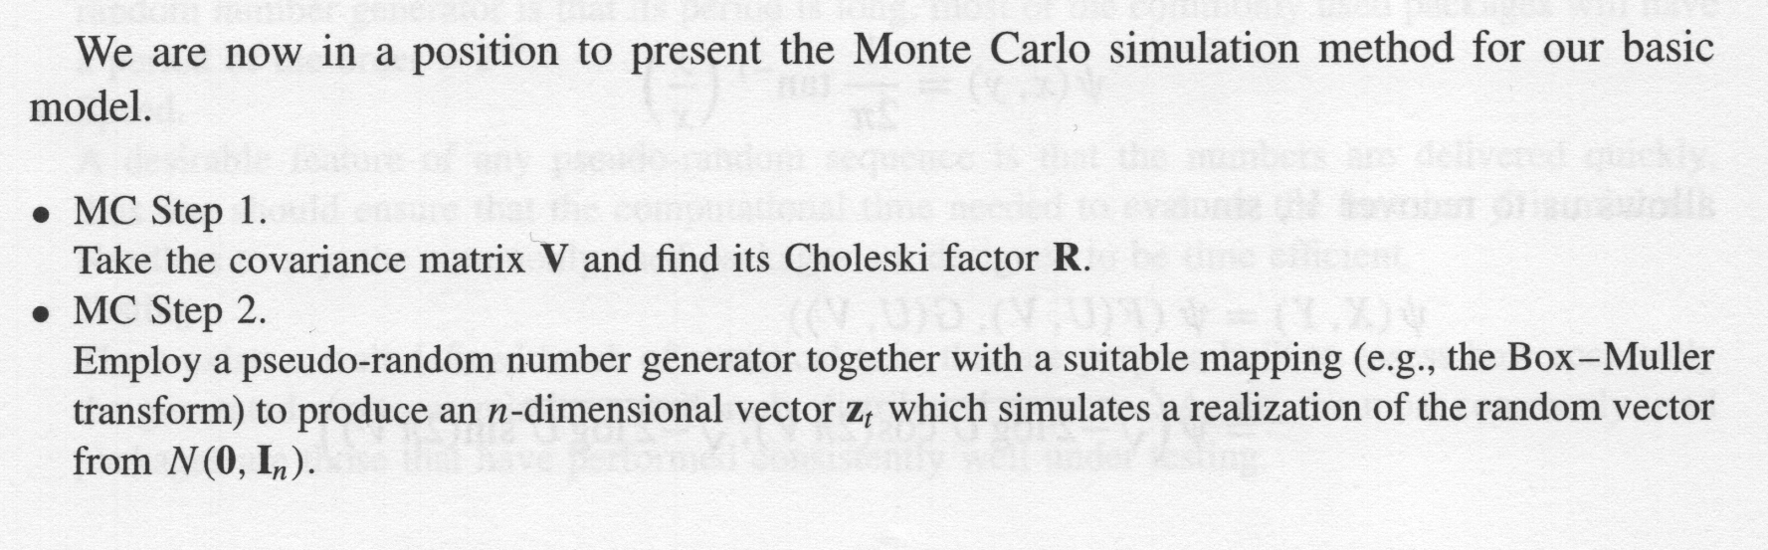
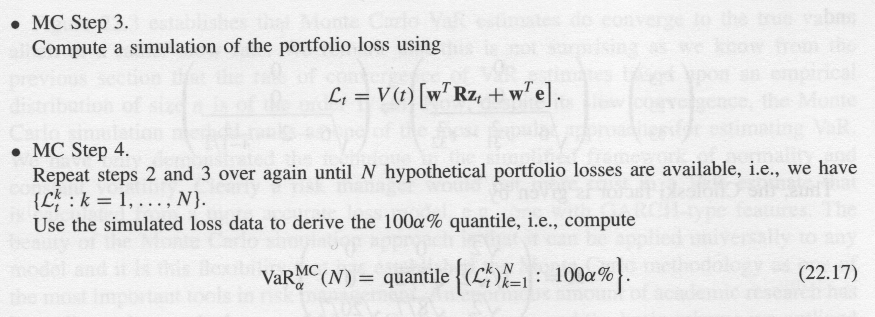
Full Portfolio Method:

Slide 66
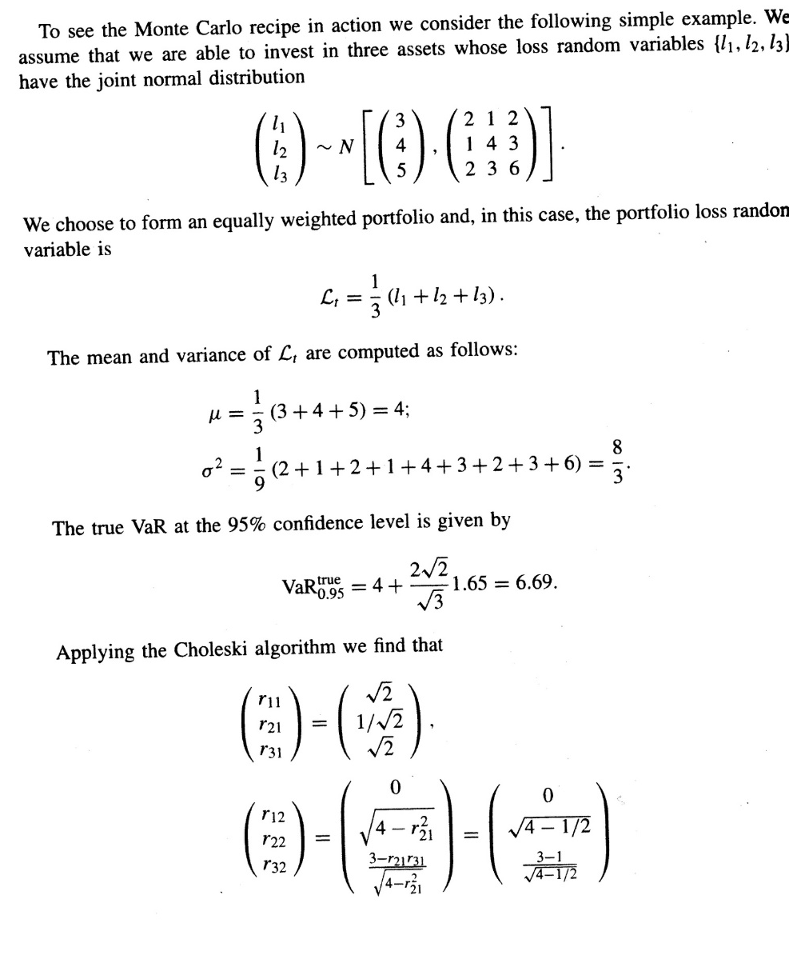

Slide 67
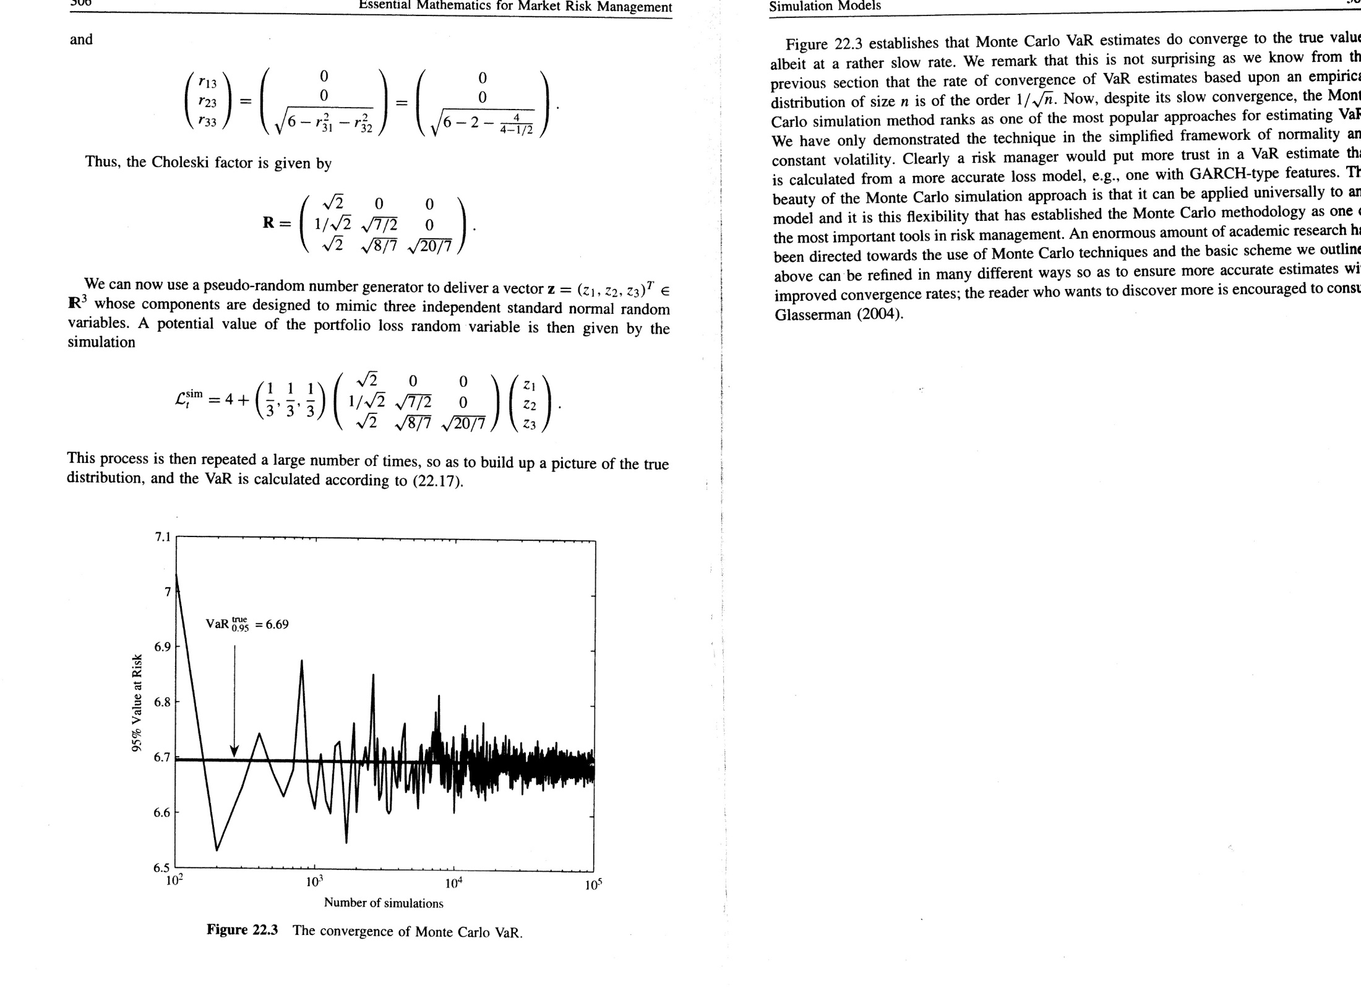

Slide 69
Ricardo A. Collado
rcollado@stevens.edu
(201) 216-8156

